Slide 1


Slide 2
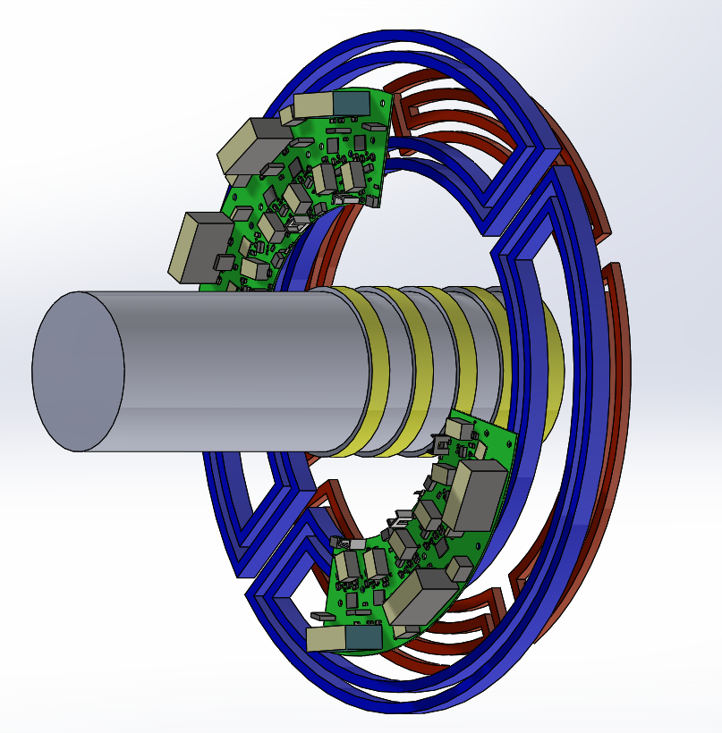
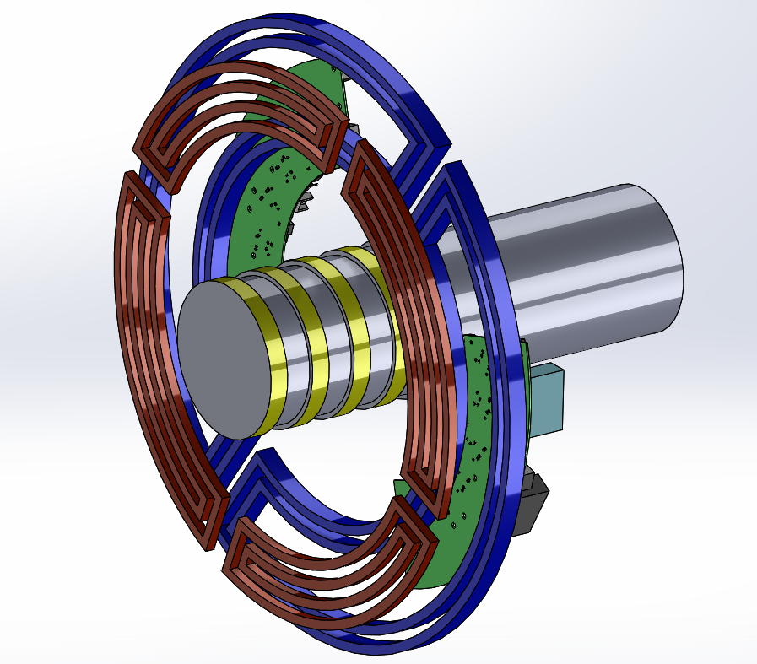

Slide 3
Outline
Contactless Slip Ring
Slip Rings in Wind Power Applications
Why Contactless Slip Ring ?
Inductive Power Transfer
Planar Transformer and Coils
Fundamental Concepts
Short Summary
Series-Series Resonant Converter
SiC Application
Overall Summary

Slide 4
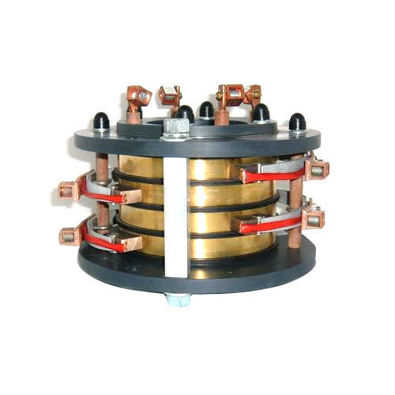
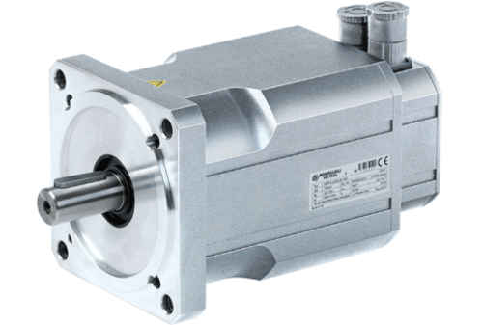

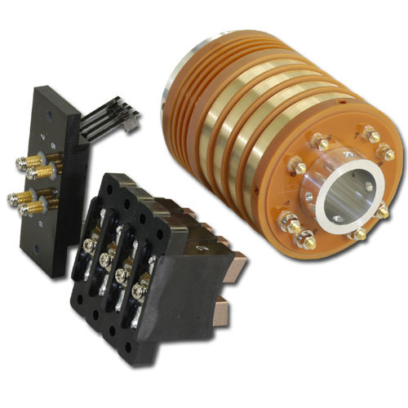
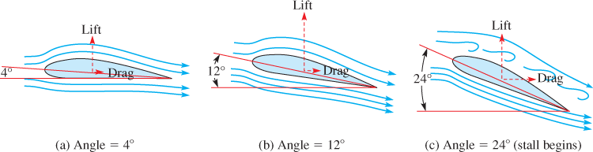
Slip Rings in Wind Power Applications
Power input
Power input
Blade pitch angle
control
Stationary frame
Rotating frame

Slide 5
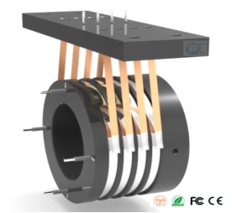
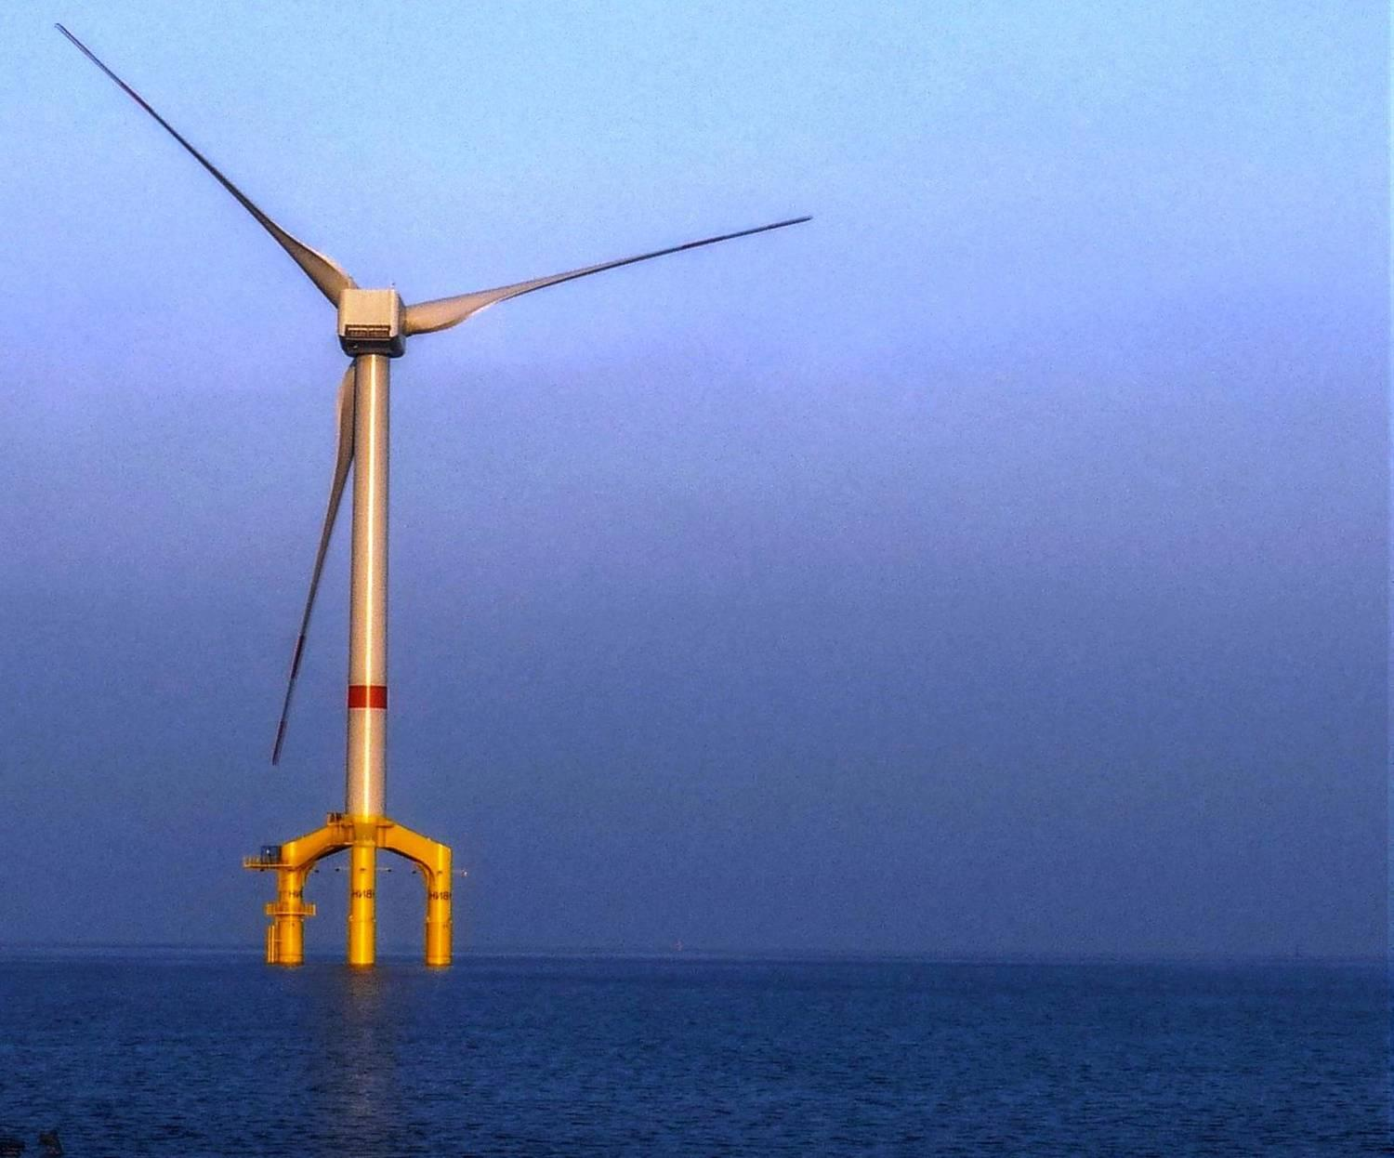
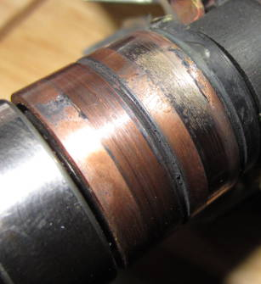
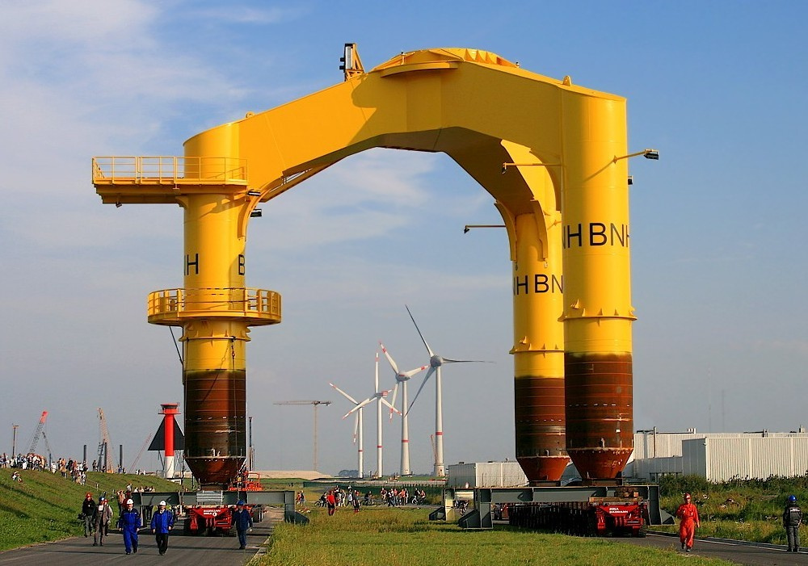
Why Contactless Slip Ring ?
Need for constant maintenance
Outage due to brush failure

Slide 6
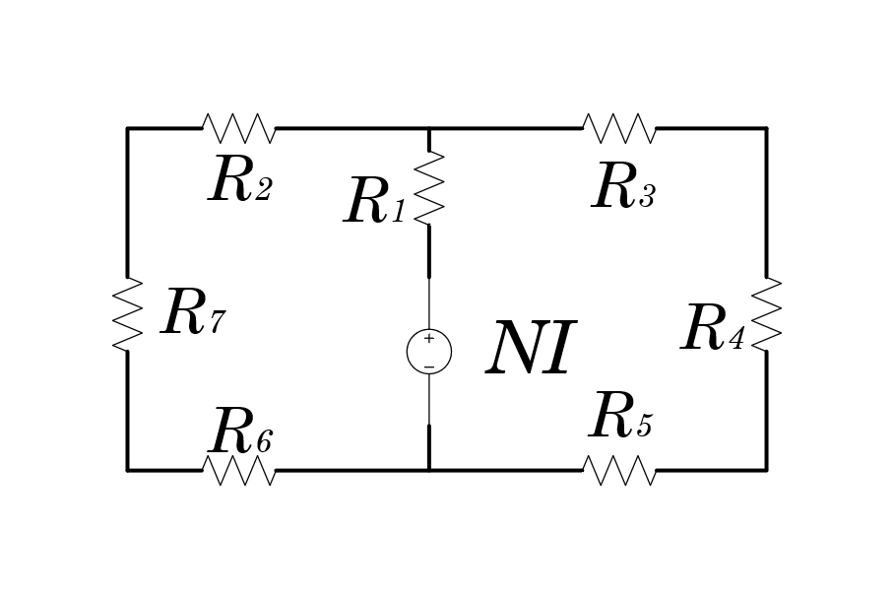
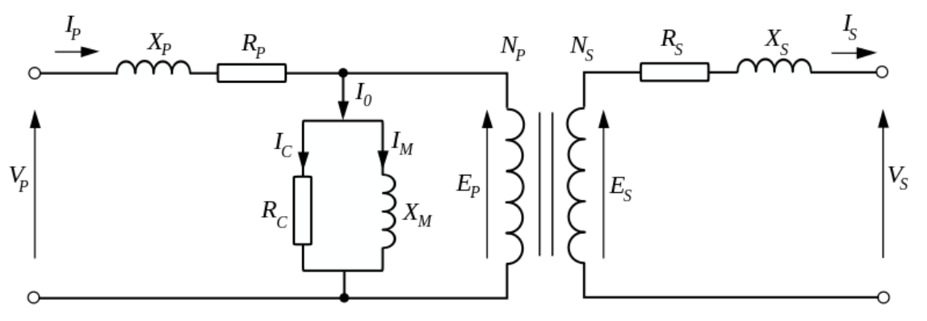
Inductive Power Transfer

Slide 7
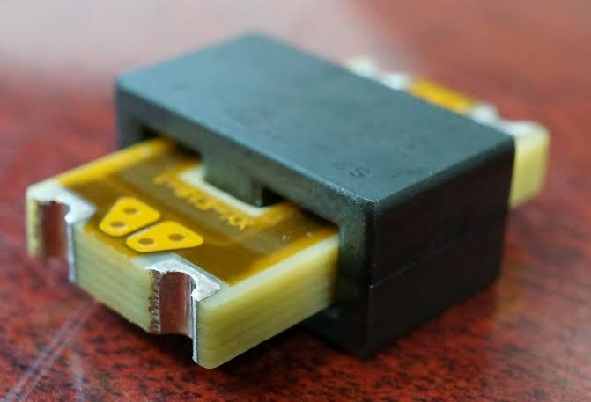
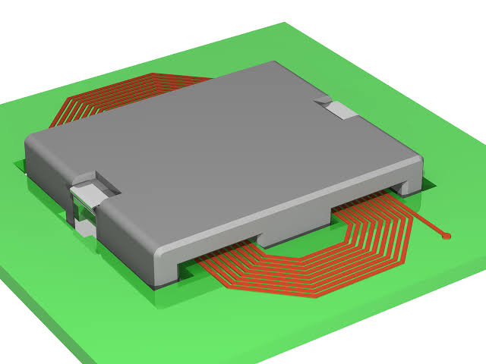
Planar Transformers

Slide 8
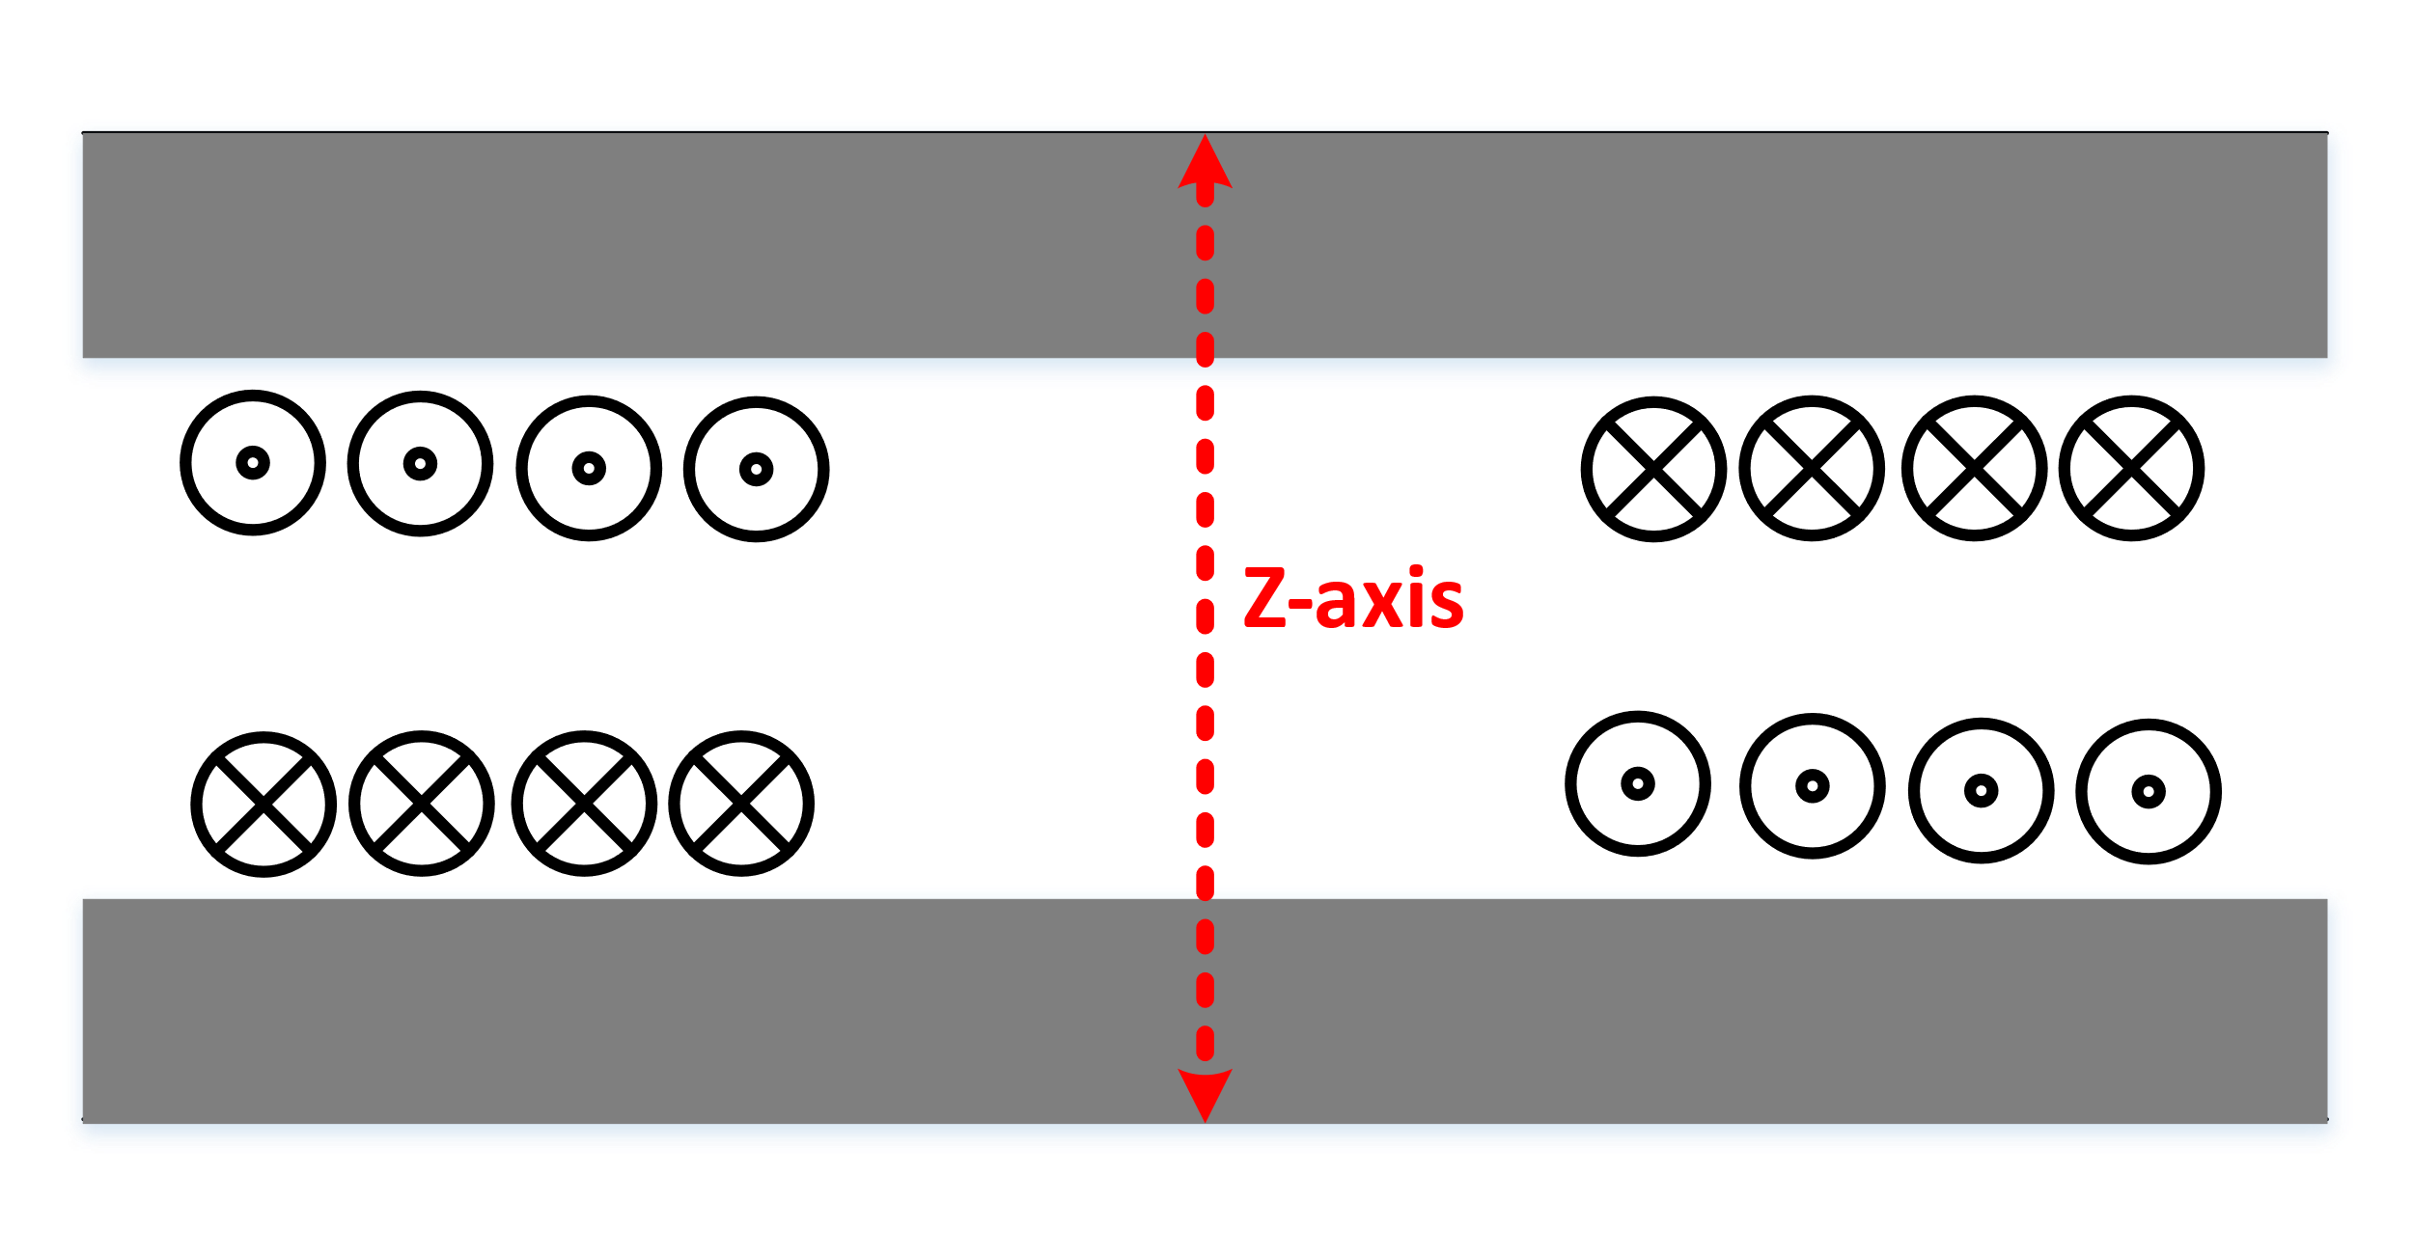
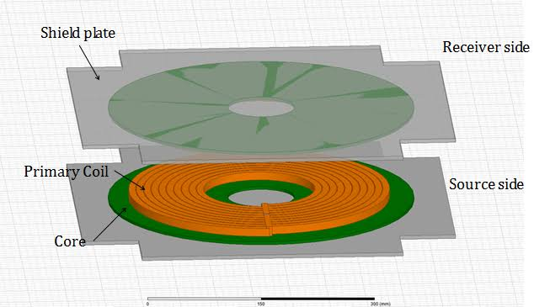
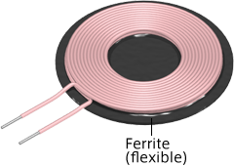
Planar Coils

Slide 9
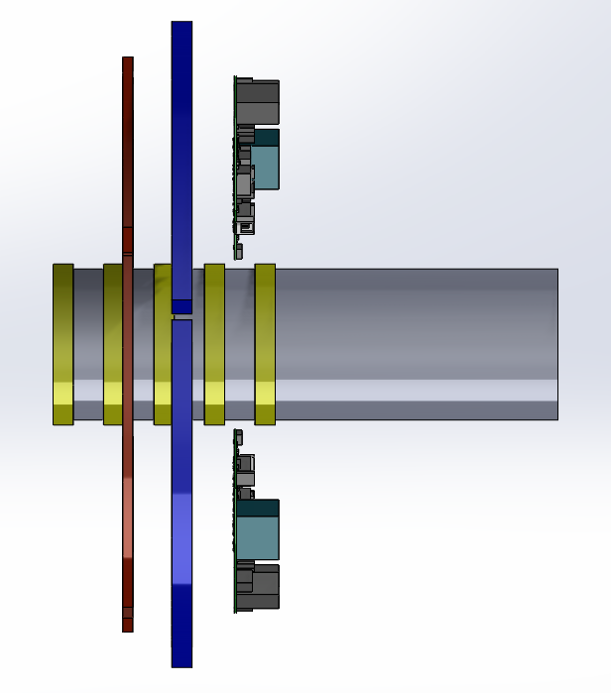
Planar Coils in Contactless Slip Rings

Slide 10
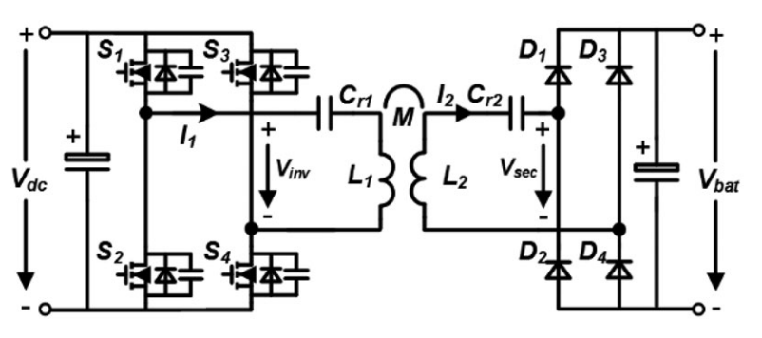
Series-Series Resonant Converter
Primary Resonant Capacitor
Secondary Resonant Capacitor
Coils
Full Bridge Converter
Full Bridge Rectifier
[1] H. Feng, T. Cai, S. Duan, X. Zhang, H. Hu, and J. Niu,
“A Dual-Side-Detuned Series-Series Compensated Resonant
Converter for Wide Charging Region in a Wireless Power Transfer System
” IEEE Trans. Ind. Electron., vol. 65, no. 3, pp. 2177–2188, 2018.

Slide 11
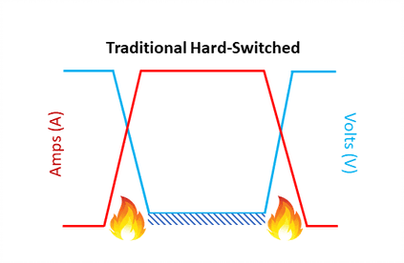
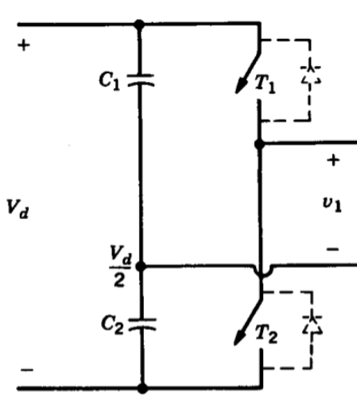
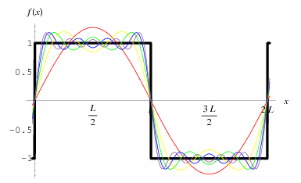
Half Bridge Converter
DC- AC Converter
[2] . Mohan, T. M. Undeland, and W. P. Robbins
“Power electronics, converters, applications and design,”
John Wiley & Sons, Inc, 2003.

Slide 12
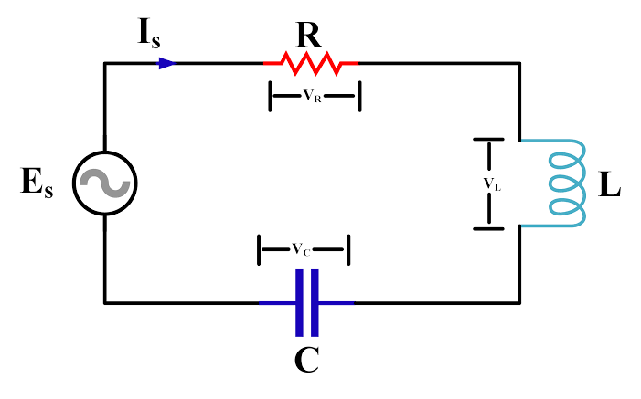
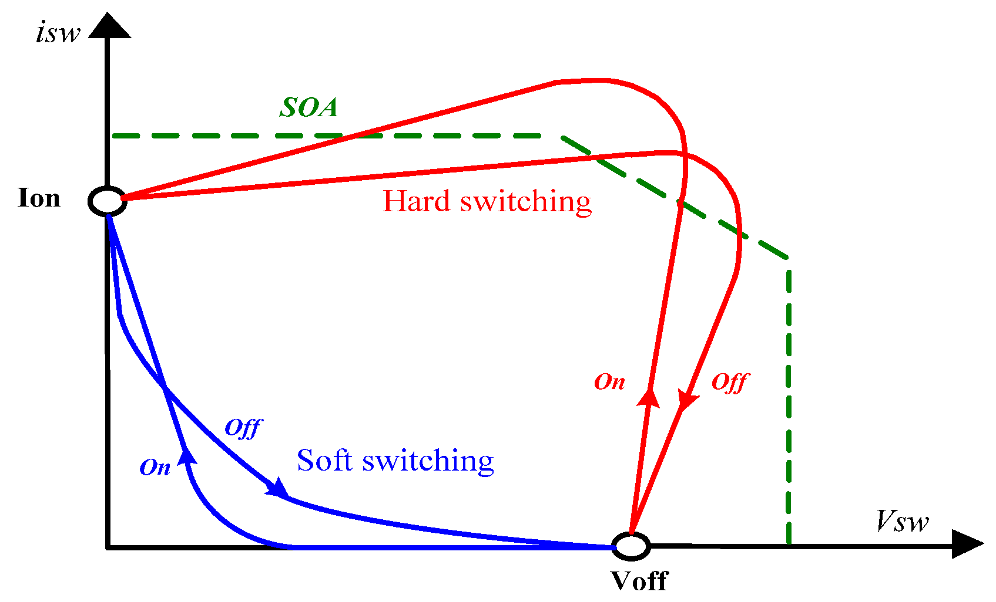
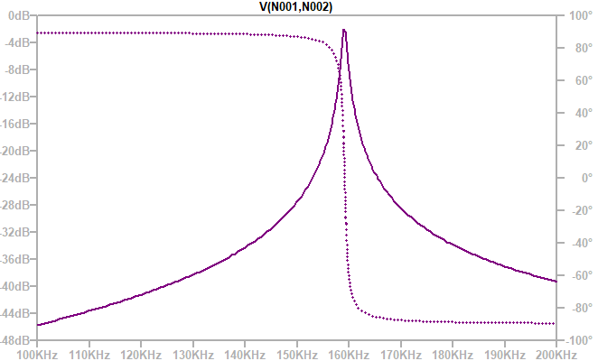

Soft Switching
RLC-Resonant Circuit
Allows higher frequency operation
Less switching loss
Higher efficiency
In phase when $ω=ω_{0}$
[3] EE464 Lecture notes keysan.me

Slide 13
Short Summary

Slide 14
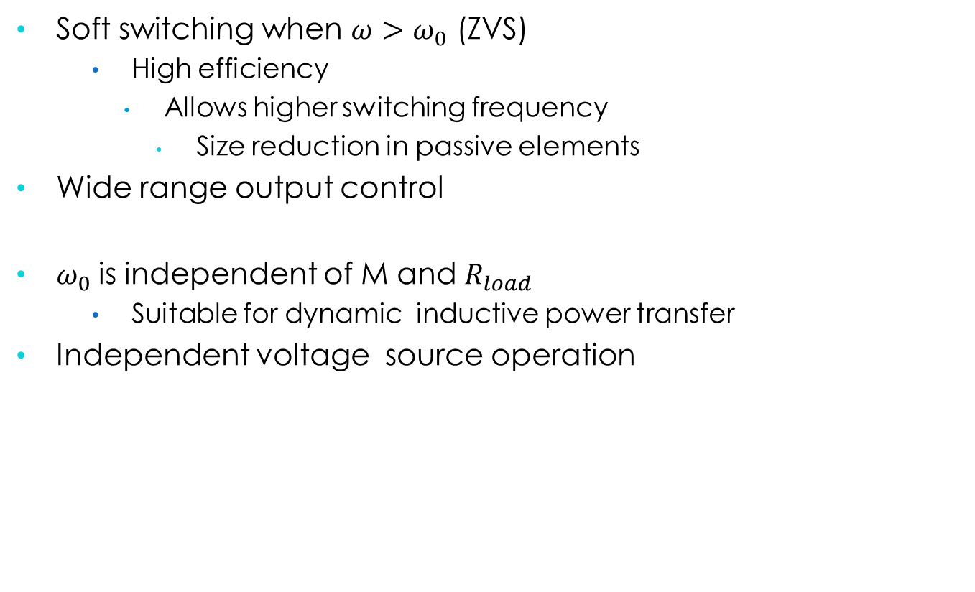
Why Series-Series Resonant Converter?
Soft switching when $ω>ω_{0}$ (ZVS)
High efficiency
Allows higher switching frequency
Size reduction in passive elements
Wide range output control
$ω_{0}$is independent of M and $R_{load}$
Suitable for dynamic inductive power transfer
Independent voltage source operation

Slide 15
Series-Series Resonant Converter
Primary Resonant Capacitor
Secondary Resonant Capacitor
Coils
Full Bridge Converter
Full Bridge Rectifier

Slide 16
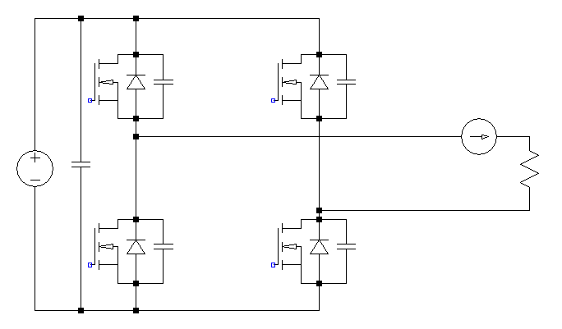

S1
S3
L-C Resonant
Tank
$${2V}_{dc}$$
R’load
S2
S4

Slide 17
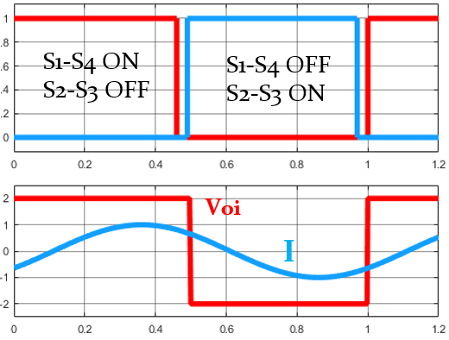
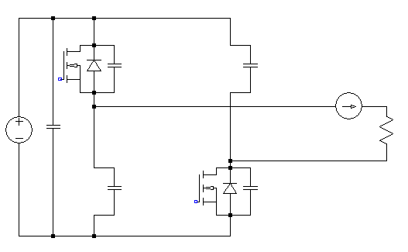



+
$$V_{dc}$$
-
$${2V}_{dc}$$
R’load
+
$$V_{dc}$$
-

Slide 18
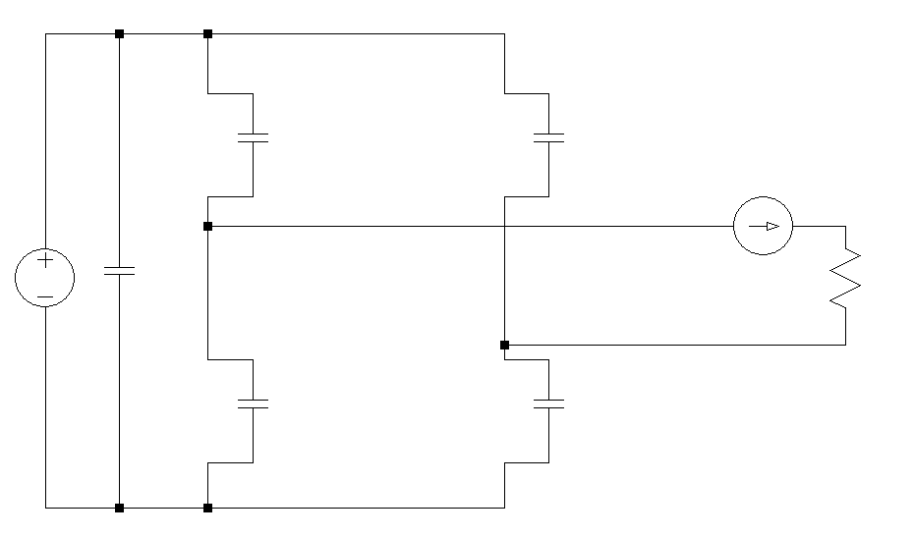
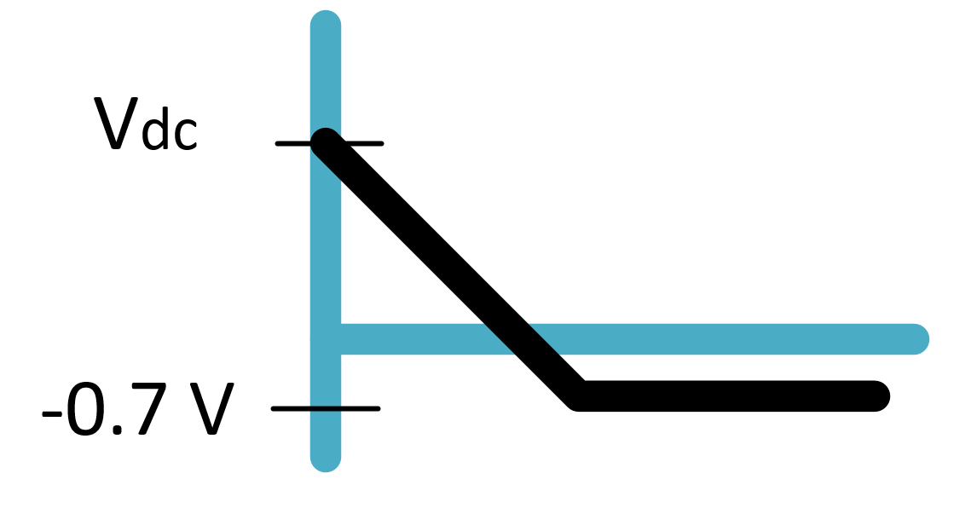




$${2V}_{dc}$$
+
+
$$V_{dc}$$
-
-
$${2V}_{dc}$$
R’load
+
+
$$V_{dc}$$
-
-

Slide 19
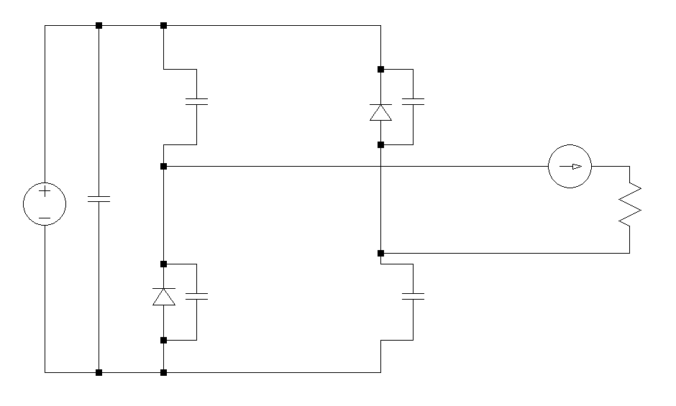

+
-0.7V
-
$${2V}_{dc}$$
R’load
+
-0.7V
-

Slide 20
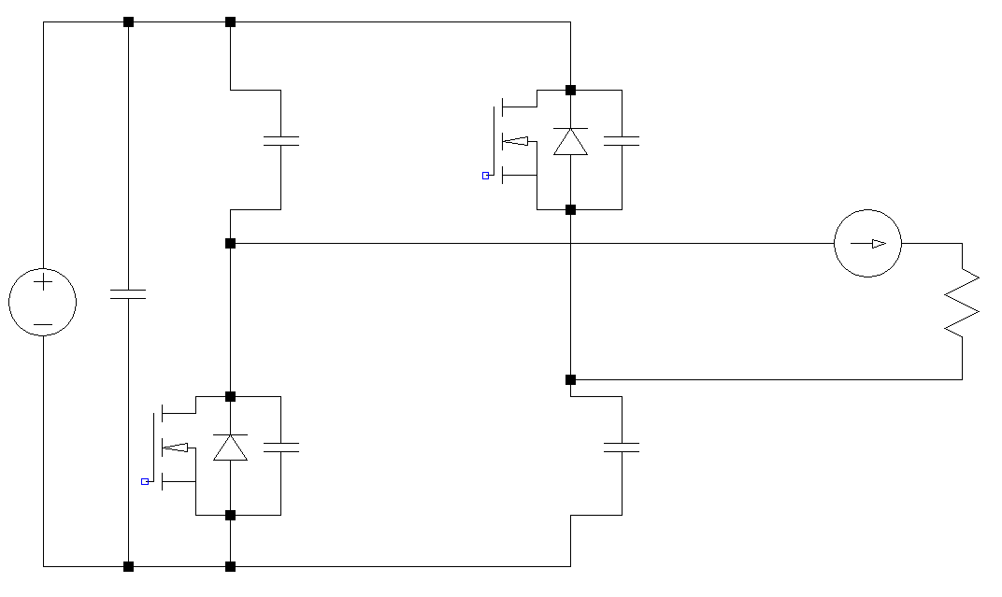

$${2V}_{dc}$$
R’load

Slide 21
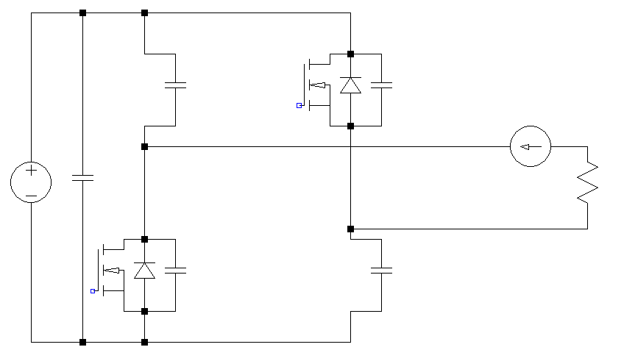



+
$$V_{dc}$$
-
$${2V}_{dc}$$
R’load
+
$$V_{dc}$$
-

Slide 22
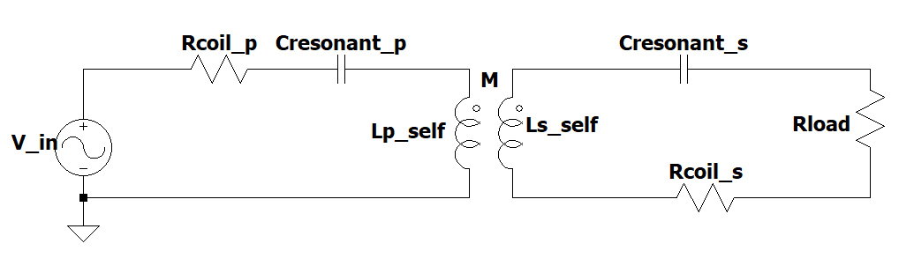
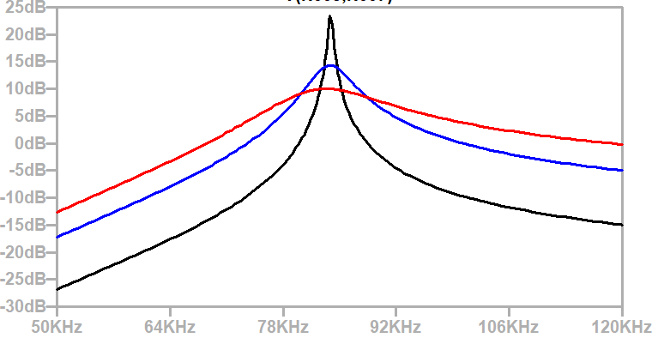
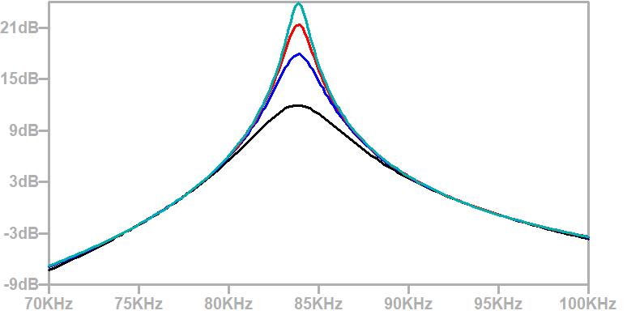


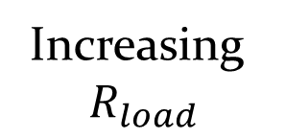
Series-Series Resonant Converter Gain Plot
$$\frac{V_{out}}{V_{in}}$$
$$\frac{V_{out}}{V_{in}}$$
Increasing
$$R_{load}$$
Increasing
M

Slide 23
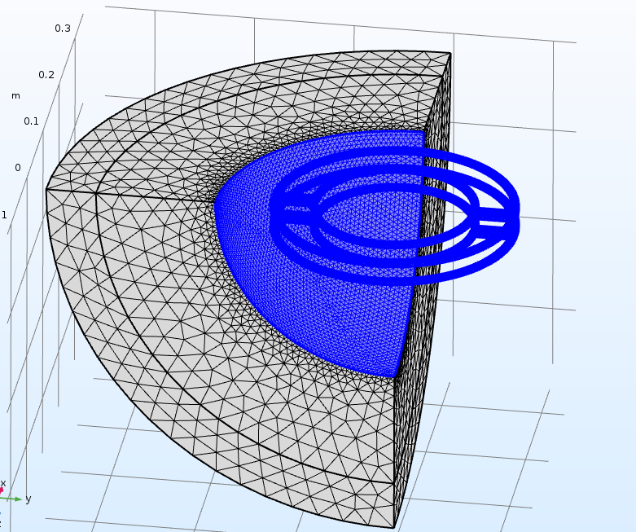
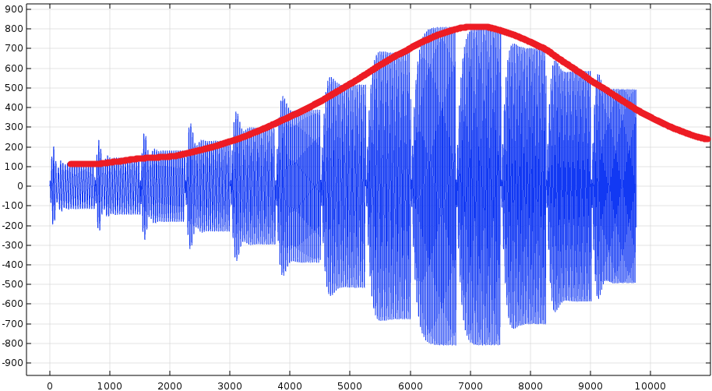
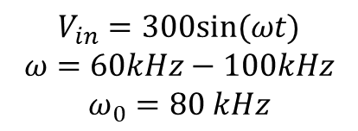
Finite Element Analysis
$$V_{in}=300sin⁡(ωt)$$
$$ω=60kHz−100kHz$$
$$ω_{0}=80 kHz$$
Air
Coils
Load Voltage vs. Frequency

Slide 24
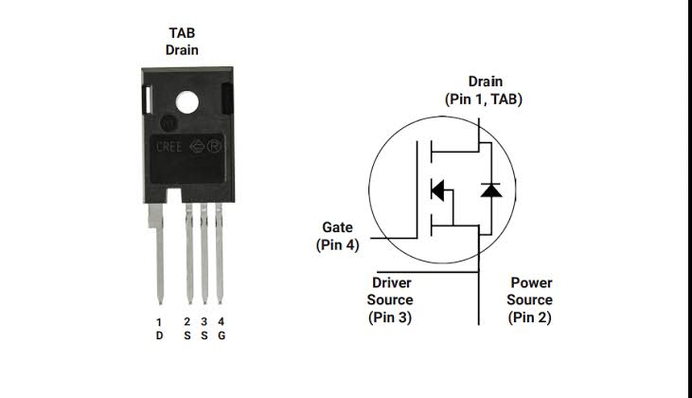
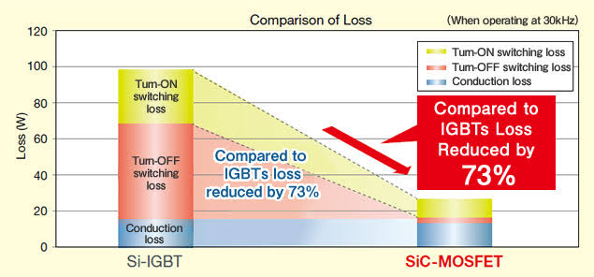
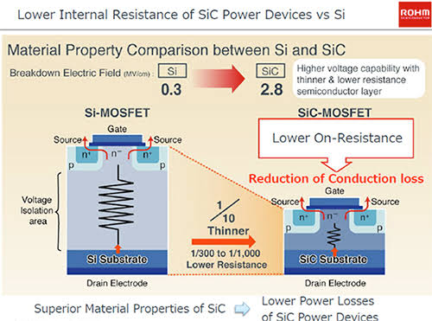
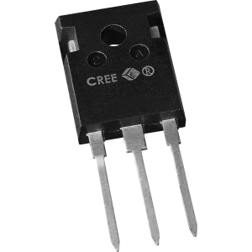
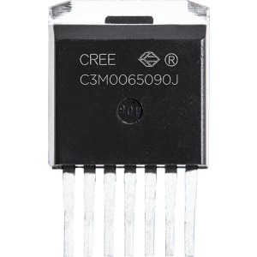
SiC Power MOSFET
[4] https://www.rohm.com/sic/sic-mosfet

Slide 25
Summary

